Slide 1
Driver Drowsiness Detection System
Beginner-Friendly Overview
How the system detects sleepiness using AI + Camera
Mamona Sadaf – Research And Devolpment
Minahel Ahsan – Simulation and Algorithms
Sarah Omer – Embedded and Hardware

Slide 2
System Goal
Monitors driver face in real time
Detects sleepiness indicators
Warns driver before danger
Works day & night

Slide 3
How System Sees the Driver
Infrared (IR) camera captures face
Facial points detected using AI
Works even in darkness

Slide 4
Detecting Eye State
Eye region cropped & stabilized
AI model classifies OPEN vs CLOSED
Long closure → Sleepiness detected

Slide 5
Detecting Yawning
Measures mouth opening width
Large sustained opening = Yawn
Frequent yawns = fatigue

Slide 6
Temporal Filtering
Blinks are fast, yawns are slow
Checks how long eyes/mouth stay closed/open
Reduces false alarms

Slide 7
Alarm Activation
Triggers sound alert
Screen shows: Normal, Yawning, Drowsy
Helps prevent accidents

Slide 8
Algorithms
MediaPipe Face Mesh – landmark detection
ROI Correction – stable eye region
CNN – eye open/closed classification
MAR – mouth opening measurement
Temporal Logic – blink vs microsleep
The pipeline works by detecting precise facial landmarks (MediaPipe) → stabilizing the eye region (ROI Correction) → classifying eye state (CNN) → measuring yawns (MAR) → using timing rules (Temporal Logic) to decide real drowsiness vs normal behaviors.

Slide 9
MediaPipe Face Mesh
468 facial landmarks
Robust in low light
Handles head movement

Slide 10
CNN Eye Classification
Learns eye patterns
More robust than geometric methods
Handles IR images and glasses

Slide 11
Mouth Aspect Ratio (MAR)
Geometric yawn detection
Lightweight & fast
No extra CNN required

Slide 12
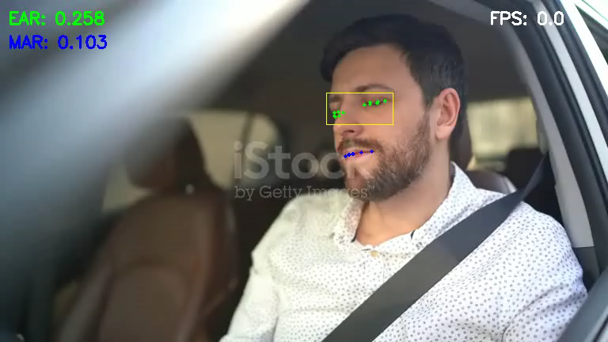
Prototype

Slide 13
Jetson Nano Integration Issues
Limited 4GB RAM
Heavy GPU load from AI models
Thermal throttling
Lower FPS under load
IR noise affects landmarks

Slide 14
Final Summary
Multi-stage AI pipeline
Accurate day/night drowsiness detection
Embedded optimized (Jetson Nano)
Reliable & real-time

